Slide 1

Forecasting Neighborhood-Level Fire Risk in Montreal
Phase 1 : Exploratory Data Analysis Results and Initial Findings
Team 3 : Osama Wanis, Hammed Akande, Pak Lo, Ekue Afanou
September 30, 2025
Notes:
SAM : 1-7
HAMMED : 8-11
Ekué : 12-14
Pak: 15-19

Slide 2

Outcome
Introduction & Objectives
Exploratory Data Analysis (EDA)
  Data qualities issues (fire incidents)
Key Insights & Next Steps
  Overview and temporal trends analysis
    General overview of incidents
    Temporal evolution (by month/week/day)
    Seasonality analysis
  Incident type distribution
  Geographic distribution of fire incidents
  Directions for predictive modeling or prevention strategies
Notes:
SAM

Slide 3
1 - Introduction & Objectives
[2]
Notes:
SAM

Slide 4
Introduction & Objectives
Context of fire risk forecasting project in Montreal
Fire incidents pose risks to public safety, property, and urban resilience.
Understanding when and where fires occur can support prevention and resource planning.
Support the development of prevention policies.
Purpose of the EDA
Identify data issues such as inconsistent date and time format and missing columns
Examine temporal and spatial patterns of fire incidents.
Explore relationships with demographic and geographic factors.
Notes:
SAM

Slide 5
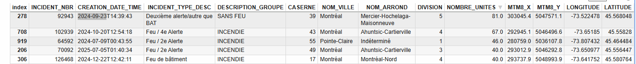
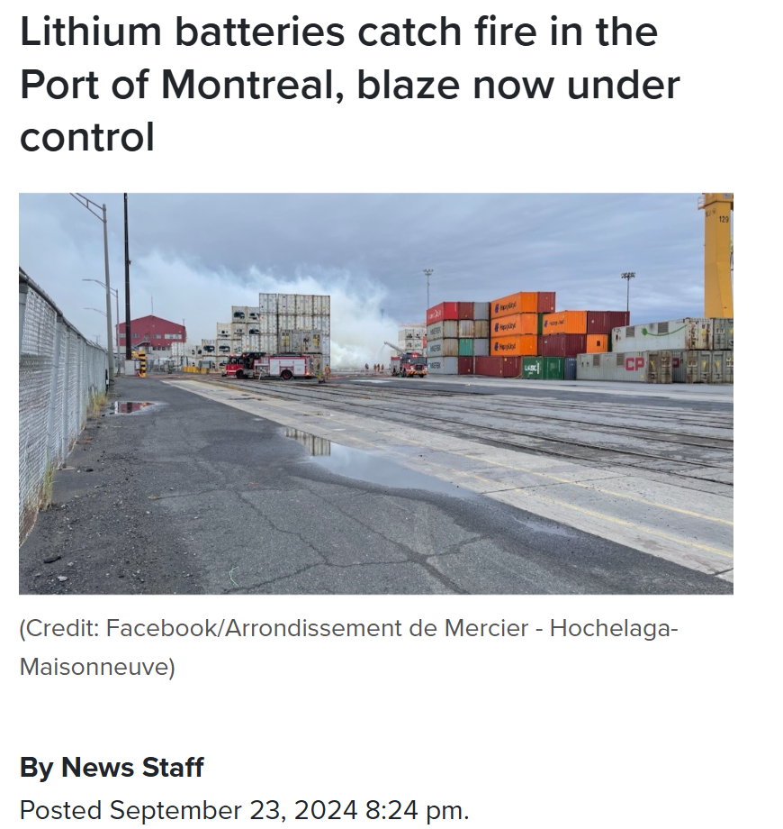
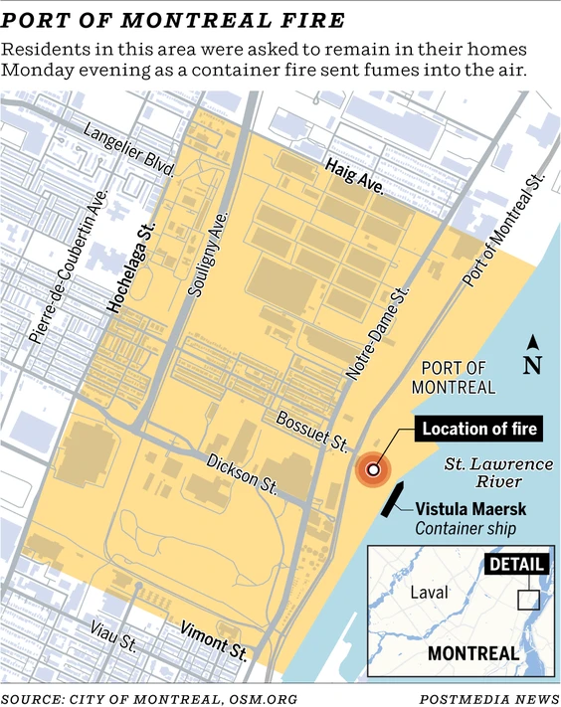
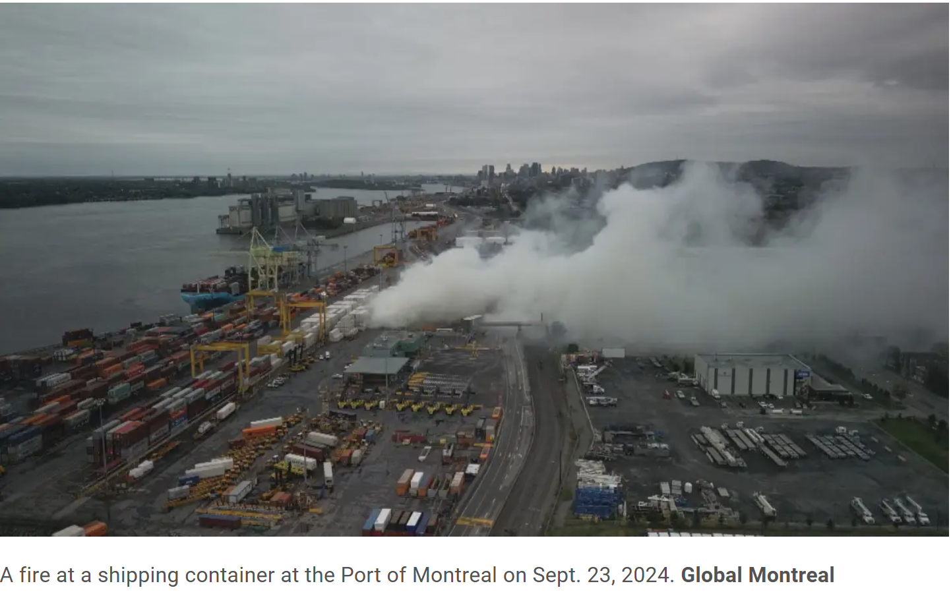
Purpose of the EDA
Notes:
SAM

Slide 6

Exploration of Data Sources
Datasets | Explored (EDA) | Included in this presentation | More Exploration in the future
Interventions
Crime
Property Assessment
Fire stations
Census Program Data
[1]
Notes:
SAM

Slide 7
2 - Exploratory Data Analysis (EDA)
[2]
Notes:
HAMMED

Slide 8
Crime Dataset – Challenges for Integration
Time Coverage Mismatch
Crime data spans 2015–2025, while fire incidents cover 2005–2025 → missing 10 years of overlap.
Incomplete Geolocation Data
Over 55,700 records lack X/Y or latitude/longitude, making spatial analysis less reliable.
No Straightforward Mapping / No Direct Relationship
PDQ-to-neighborhood links in the crime dataset don’t align directly with neighborhood data in the fire incidents dataset, limiting correlation.
[1]
Notes:
Sam

Slide 9
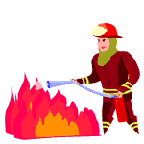
Data Sources & Preparation
Montreal Fire Interventions (2005–2024)
Service de sécurité incendie de Montréal (SIM)
This EDA examines nearly two decades of emergency calls handled by Montreal firefighters.
We explore data quality issues, uncover key patterns and outline how modelling can support decision‑making.
[1]
Notes:
HAMMED

Slide 10
Data Issues
Missing values & overlaps
Missing columns: the intervention dataset from 2005 to 2014 does not have columns MTM8_X and MTM8_Y
Data segmented into : 2005–2014, 2015–2022,2020-2023 and 2024-2025.
2020–2023 file overlaps with 2015–2022, causing duplicates when merging.
Inconsistencies & privacy
Incident category names : The names change over time (e.g. ‘Premier répondant’ vs ‘1‑REPOND’).
Date : the format is inconsistent : yyyy-mm-ddThh:mm:ss & mm/dd/yyyy
Notes:
HAMMED

Slide 11
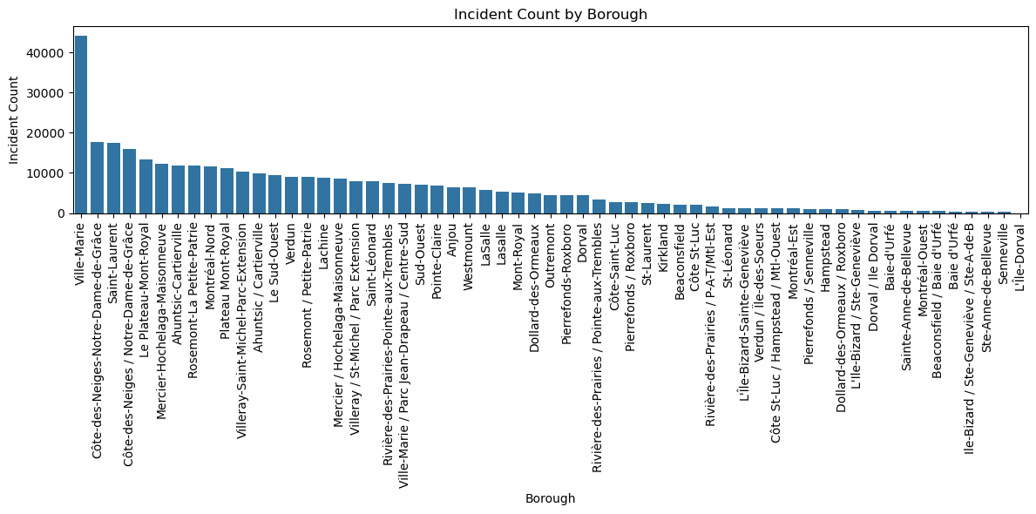
Data Issues
Inconsistencies & privacy
Municipalities Names :
  Some municipalities (such as Pointe-Claire and Westmount) do not belong to boroughs of Montreal. “NOM_ARROND” is recorded as “Indéterminé”.
  Different namings of the same city across different datasets
    Côte-des-Neiges-Notre_Dame-de-Grâce vs Côte-des-Neiges/Notre_Dame-de-Grâce
    Ahuntsic-Cartieville vs Ahuntsic / Cartieville
Geolocation obfuscated to nearest intersection to protect privacy; affects precise spatial analysis.
Notes:
HAMMED

Slide 12
3- Key Insights & Next Steps
[2]
Notes:
Ekue

Slide 13
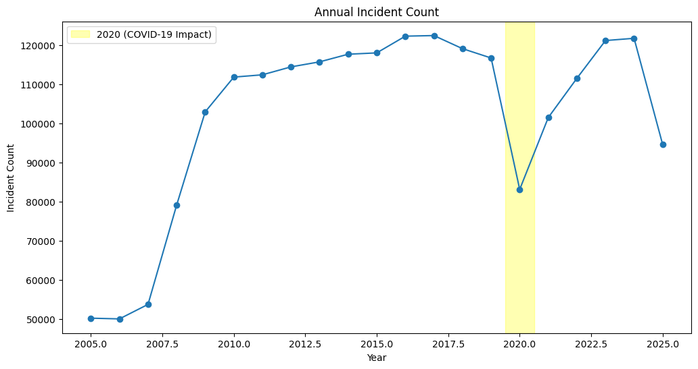
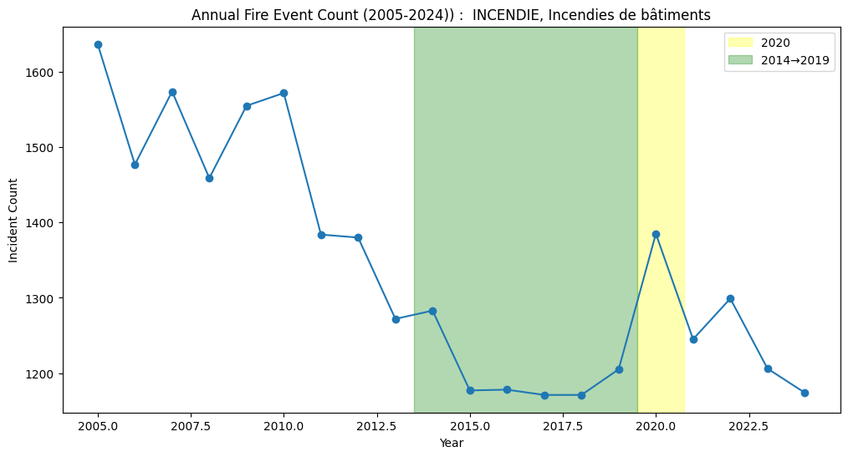
Temporal trends - General overview of incidents
Trend for all the incidents
Steady growth from ~50k calls in 2005 to over 122k by 2017.
Sharp 30% drop in 2020 coinciding with the COVID‑19 pandemic.
Recovering volumes in 2021–2024, approaching pre‑pandemic levels.
Trend for all “FIRE” incidents only
Overall Decline: Building fire incidents steadily decreased from ~1,650 in 2005 to below 1,200 after 2015, marking a ~30% reduction over two decades.
Stabilization Period: From 2014 to 2019, incidents remained relatively stable at historically low levels (~1,170–1,200 cases per year).
Recent Fluctuations: After a spike in 2020 (~1,380 incidents), counts fluctuated between 1,200–1,300, but never returned to early 2000s levels.
[1]
Notes:
EKUÉ

Slide 14
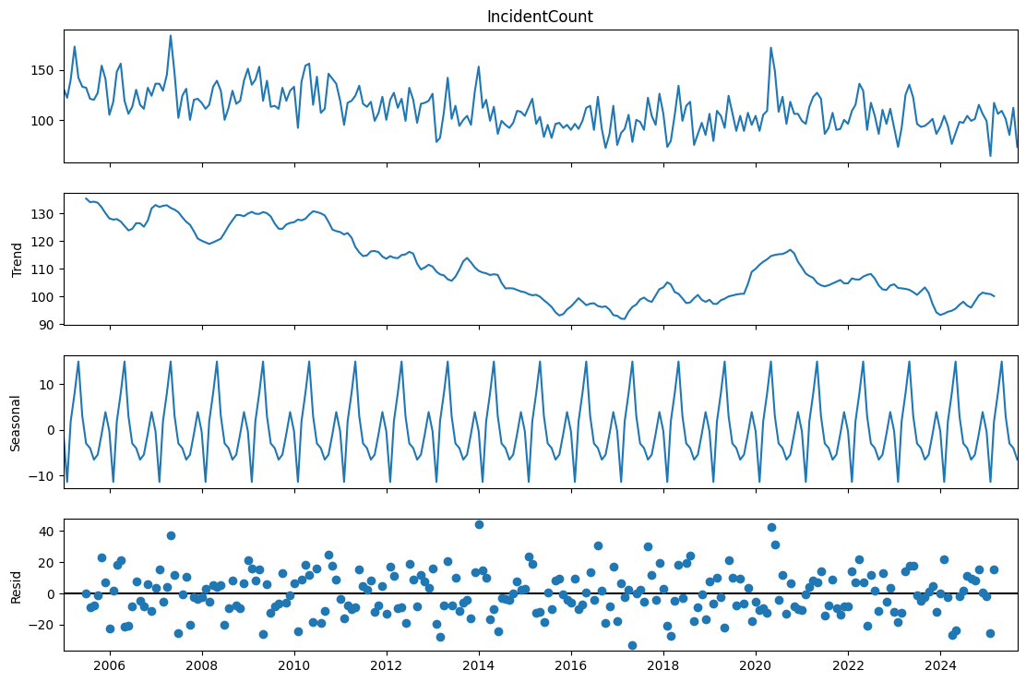
“Fire Incidents” - Seasonality analysis
Long-Term Trend: Incident counts show a gradual decline from 2005 to ~2016, followed by a slight recovery around 2018–2020, then stabilization at lower levels post-2021.
Seasonality: A strong recurring seasonal cycle is visible, with regular peaks and dips each year, suggesting predictable fluctuations in fire incidents.
Residuals: Random variations remain around the baseline, with some extreme spikes, but no persistent bias—indicating that most variability is captured by trend and seasonality.
[1]
Notes:
EKUÉ

Slide 15
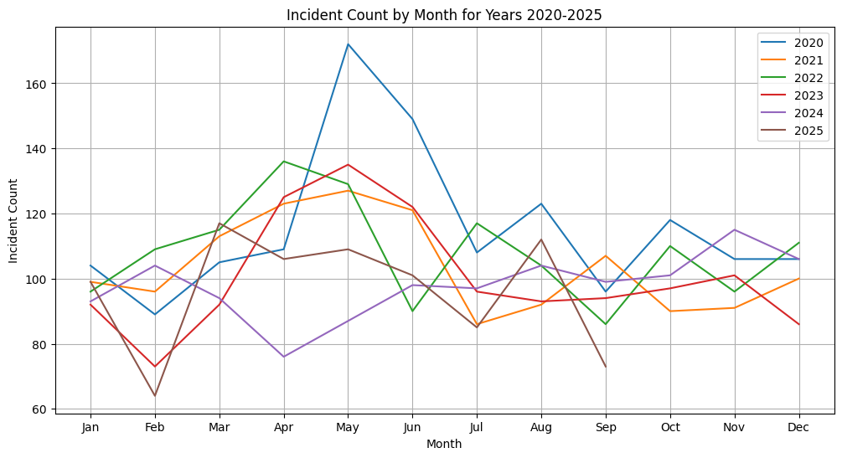
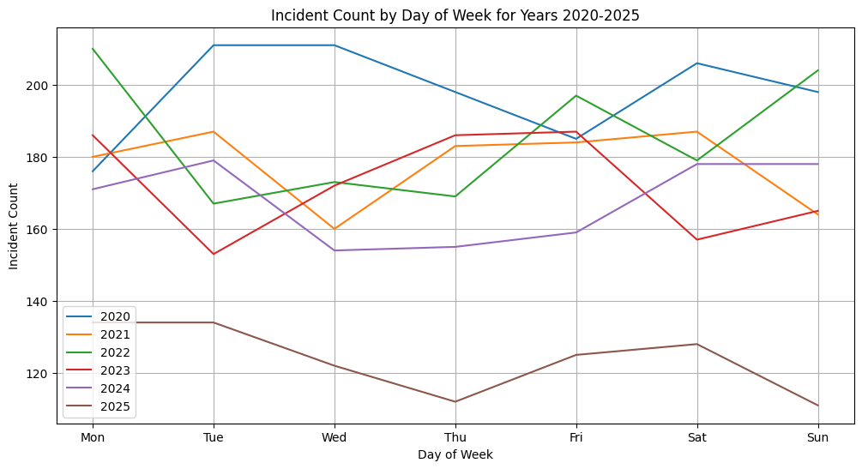
“Fire Incidents” - Temporal evolution (month/week/day)
Trend by month
Spring–Early Summer Peaks: Incidents often rise between April and June, with 2020 showing a sharp spike in May (~175 incidents).
Mid-Year Variability: After June, most years show a drop in July–August, though some rebound slightly in late summer.
Stable Autumn–Winter: From September to December, incidents generally stabilize, with fewer fluctuations compared to spring.
Trend by day
Early Week Activity: Higher incident counts are often observed on Mondays and Tuesdays, with 2020 and 2022 peaking above 200 incidents.
Midweek Variability: From Wednesday to Friday, counts fluctuate by year—some years dip (2021, 2024), others stay elevated (2023, 2022).
Weekend Contrast: Saturdays and Sundays generally show mixed patterns—2020 and 2022 remain high, while 2025 shows the lowest weekend levels (~110 incidents).
[1]
Notes:
EKUÉ

Slide 16
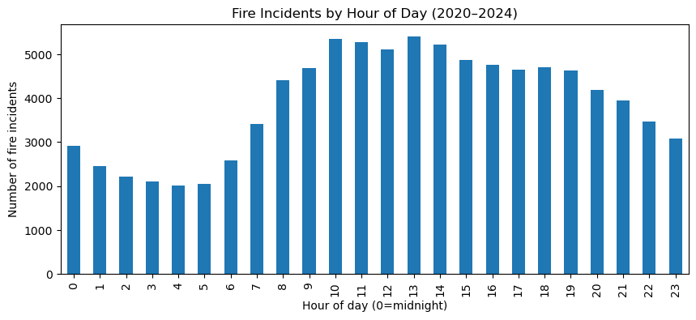
“Fire Incidents” - Temporal evolution (month/week/day)
Trend by Hour
Nighttime Low: Fire incidents are lowest between 1 AM and 6 AM (~2,000 incidents/hour), reflecting reduced activity during nighttime.
Daytime Peak: Incidents rise sharply after 7 AM, reaching their maximum between 10 AM and 1 PM (over 5,000 incidents/hour).
Afternoon Decline: After the peak, incidents gradually decrease through the afternoon and evening, though still remain higher than night levels.
Notes:
EKUÉ

Slide 17
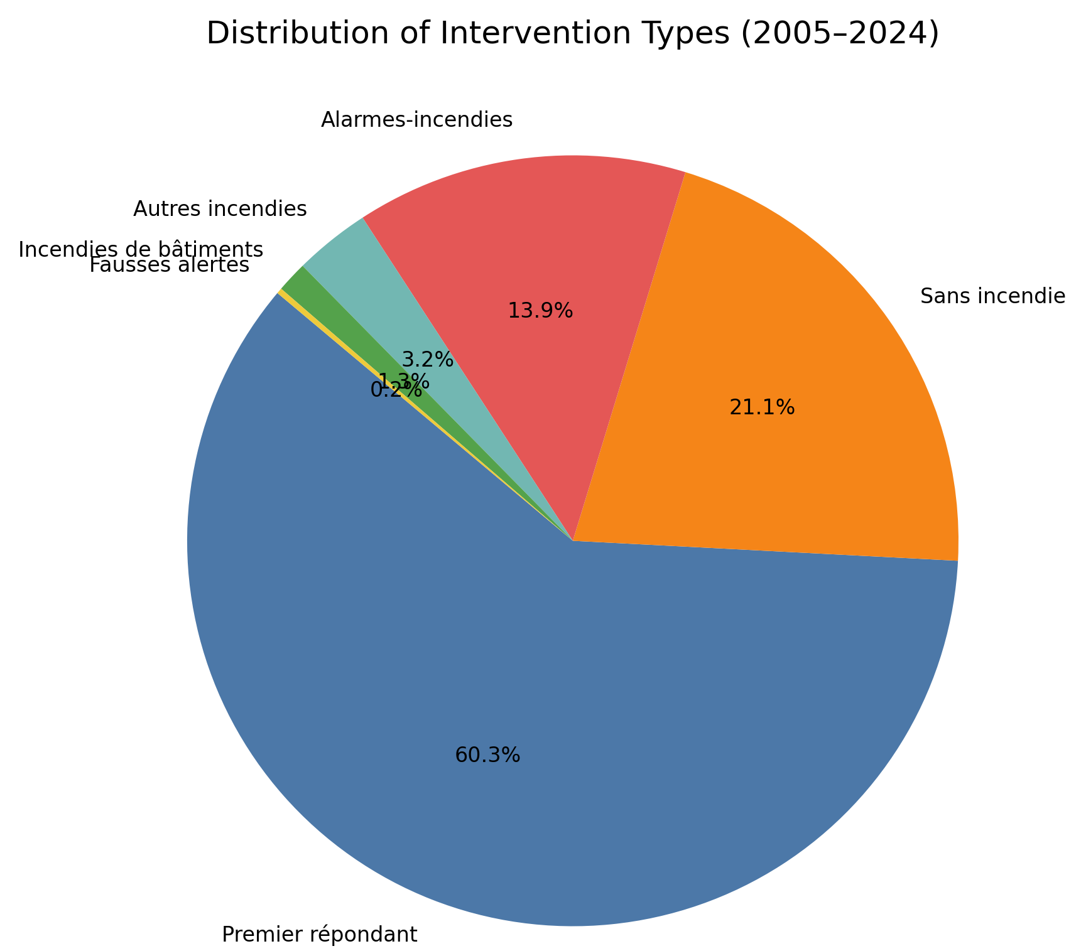
Key Insights : Incident Type
Majority: Medical Response – Over 60% of interventions are “Premier répondant” (first responder/medical aid), showing that most fire department calls are not fire-related.
Non-Fire Incidents Significant – Sans incendie (21.1%) and Alarmes-incendies (13.9%) together make up more than a third of interventions, highlighting the prevalence of false alarms or preventive responses.
Actual Fires Are Rare – True fire-related cases (Incendies de bâtiments 0.4%, Autres incendies 3.2%) represent less than 5% of all interventions.
[2]
Notes:
PAK

Slide 18
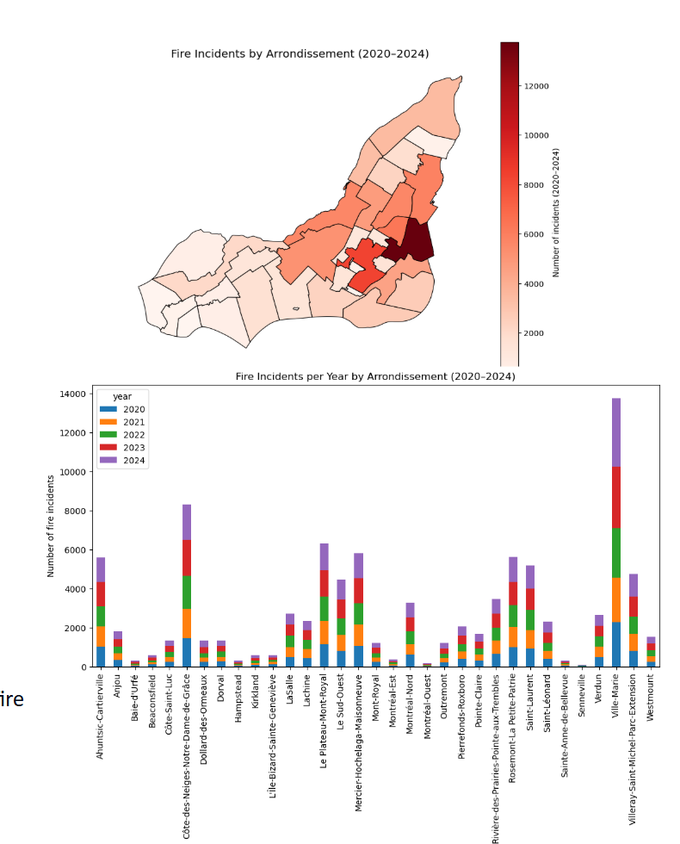
Key Insights & Next Steps : Geographic distribution
Central & Eastern Montréal : High concentration of incidents, especially in densely populated boroughs like Plateau-Mont-Royal, Rosemont, Ville-Marie, and Hochelaga.
West Island : Moderate clusters, scattered but notable in residential areas like Kirkland, Beaconsfield.
North Montréal & Laval : Distinct clusters near Saint-Laurent and Laval, showing suburban activity.
The highest density is observed in downtown and central boroughs, likely due to higher population, older infrastructure, and mixed building uses.
Peripheral suburbs show smaller clusters, possibly linked to residential fires or specific industrial/commercial zones.
Central
Key Takeaways
Fire incidents are not uniformly distributed: central Montréal is most at risk.
Suburban clusters show localized hot spots that may need targeted prevention.
Mapping highlights the potential for hotspot analysis and risk zoning for city planning and fire department resource allocation.
Notes:
PAK

Slide 19
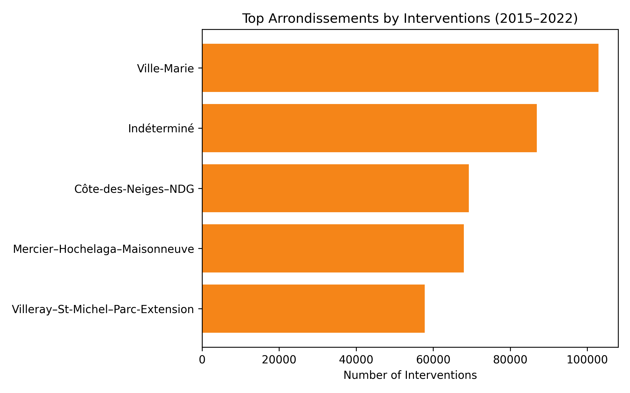
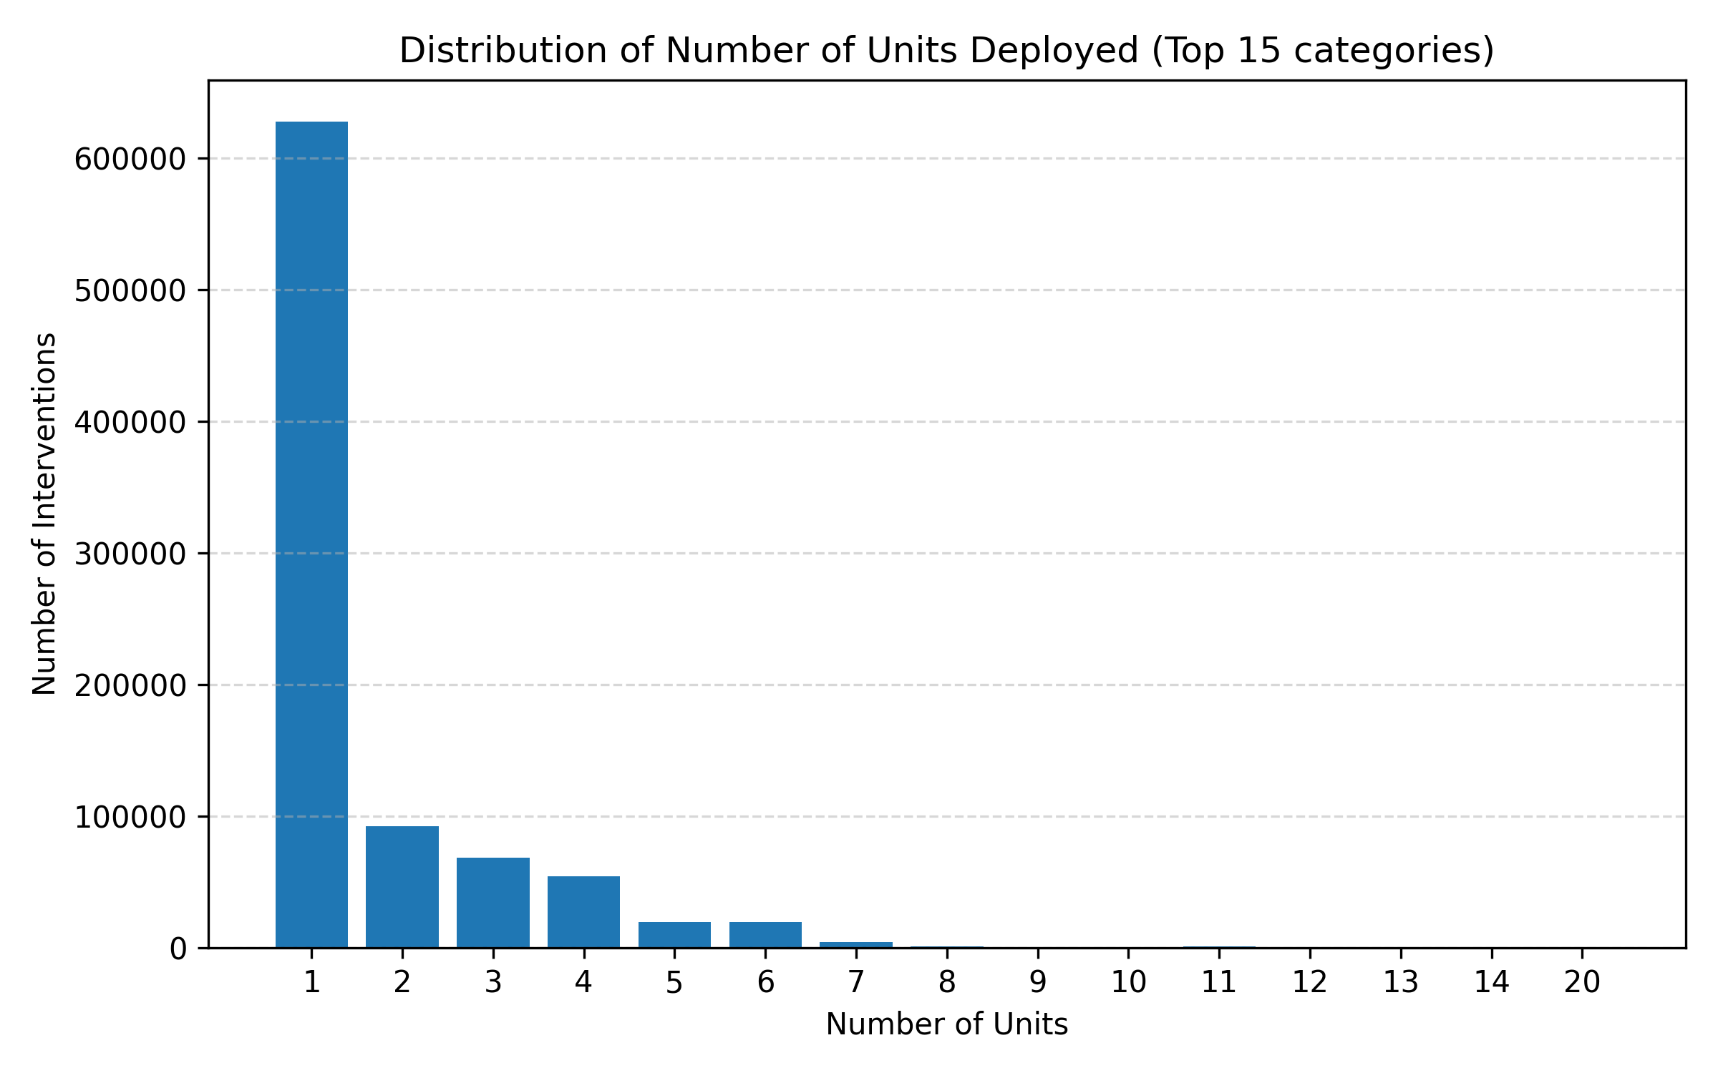
Key Insights & Next Steps : Resources & geography
Ville‑Marie is consistently the busiest arrondissement, followed by Côte‑des‑Neiges–NDG and Mercier–Hochelaga–Maisonneuve.
Most interventions deploy only 1–2 units; very few require more than 6 units.
[2][3]
Notes:
PAK

Slide 20

Next steps: Towards predictive insight
Use of geolocalisation coordinate (LAT & LONG) to create many zones grid on the map for aggregation purpose.
Exploration of the crimes, demographics and 311 datasets.
Data preparation: remove duplicates, impute missing values and harmonise category labels.
Feature engineering: derive temporal variables (hour/day/season), encode categorical variables and incorporate spatial context.
Predictive modelling: classify the fire risk for each grid to facilitate inspections.
  If time allowed, train classification models (e.g. Random Forest, Gradient Boosting) to predict incident type or required units; use time‑series models to forecast call volumes.
Evaluation & deployment: evaluate with accuracy/F1/MAE, cross‑validate; integrate insights into resource planning dashboards.
Notes:
PAK

